Slide 1
PROJECT TITAN-X TeamAce

Slide 2
Table of Contents
ABOUT TEAMAce
INTRODUCTION
APPROACH
EDA
DATA PRE-PROCESSING
ARCHITECTURE PIPELINE
CHOSEN ALGORITHMS
APPLICATION DEPLOYMENT
LIVE DEMO
CONCLUSION

Slide 3
About TeamAce
1

Slide 4



The People Behind the Project
KENG HIN CHEONG | AU QUANG LOC NGUYEN | CHUTU LI
100711777 | 100741710 | 100765238
AI Specialist | AI Specialist | AI Specialist

Slide 5
We always aim to conquer any difficulties and challenges.
“Just do it, make it happen, and ACE it!” is our team’s core spirit.

Slide 6
Introduction
2

Slide 7
Stock trading has always been a task done by trading professionals in finance, since it can be very difficult, risky, time consuming and emotionally affected.
Needs professional knowledge and experience.
Hard to make money at the end. 7/10 ordinary players lose money.
Therefore, our project aims to address the problems mentioned.
Focused on SP500 IT Sector of US Stock Market.

Slide 8
Approach
3

Slide 9



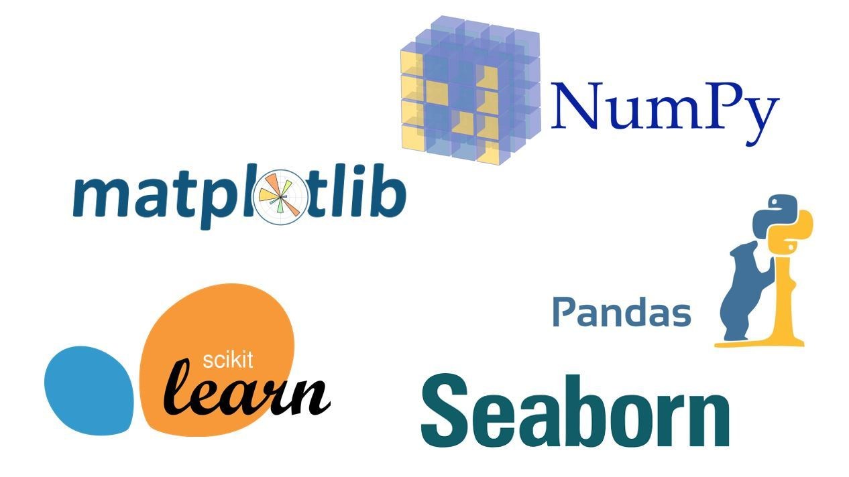

The project has three main parts:
Long Term Investment
Short Term Investment
NLP Stock Recommendations
Main tools and libraries used:

Slide 10
EDA
4

Slide 11
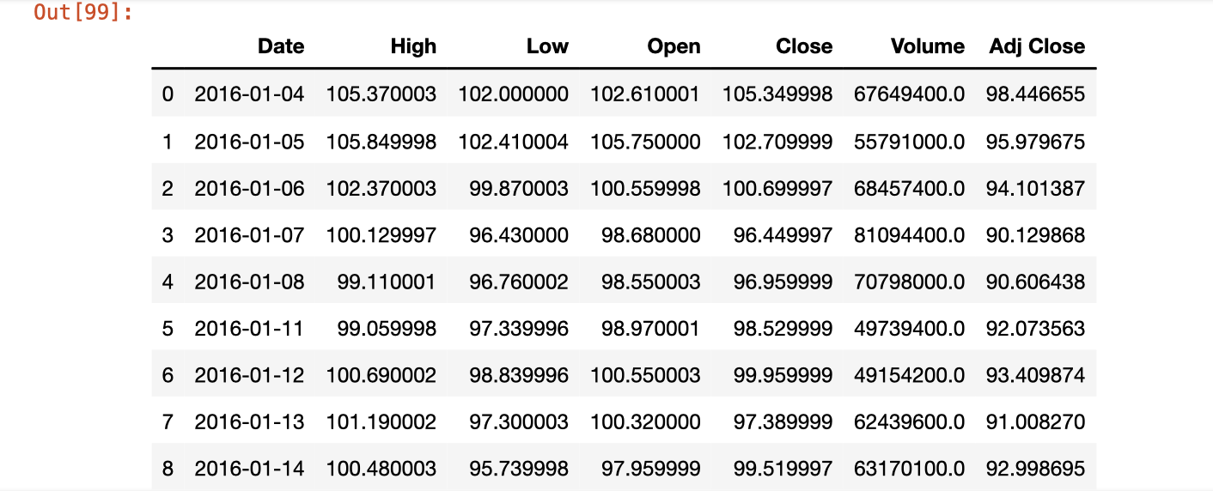
Stock Price Prediction
Using an API called 'pandas_datareader.data' to get the stock data from Yahoo Finance

Slide 12
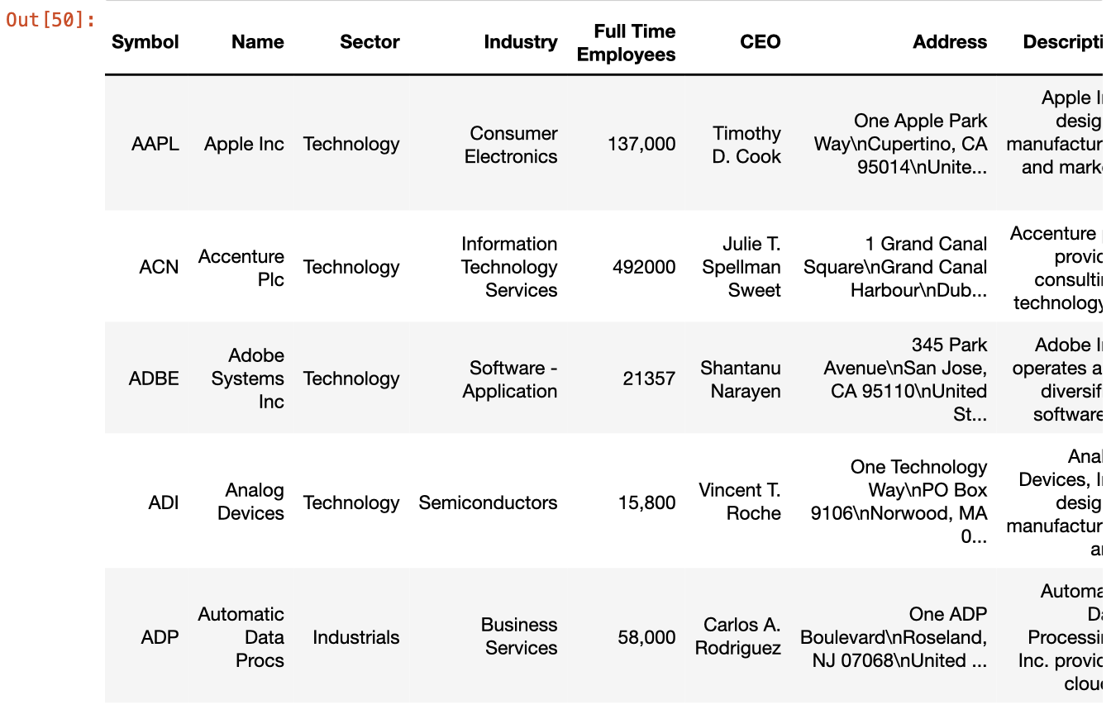
NLP
Scrapped from Yahoo Finance

Slide 13
Data Pre-Processing
5

Slide 14
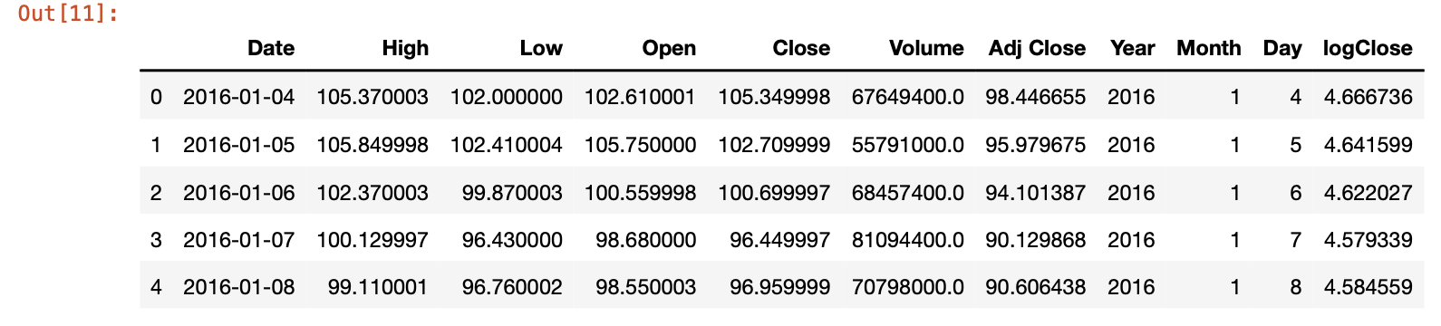
Stock Price Prediction-Long Term
Extract the year, month, day from Date
Take log of Close

Slide 15
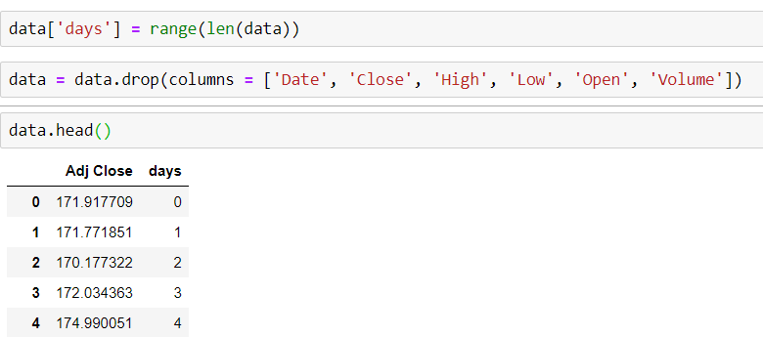
Stock Price Prediction-Short Term
Create a column date and remove unnecessary columns. We will work with Adj Close

Slide 16
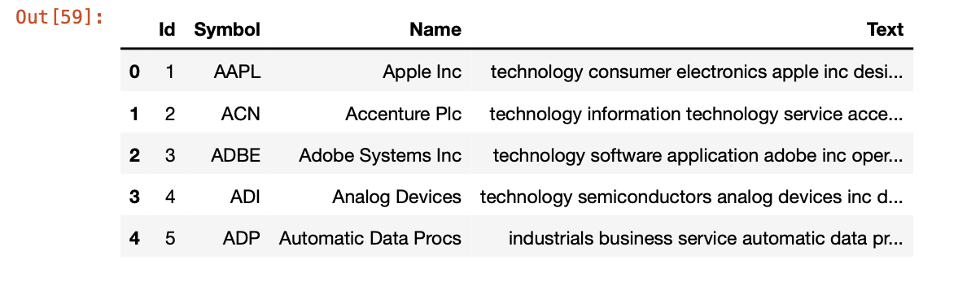
NLP
Select and combine need columns
Cleaning the fields

Slide 17
Architecture Pipeline
6

Slide 18
Stock Price Prediction-Long Term
Get Stock Data Using API
Feature Engineering
Model Training
Model Evaluation & Selection, Final Stock Price Prediction
Model Evaluation & Selection, Final Stock Price Prediction

Slide 19
Stock Price Prediction-Short Term
Get Stock Data Using API
Feature Engineering
Fuzzification
Rule generation
Forecasting

Slide 20
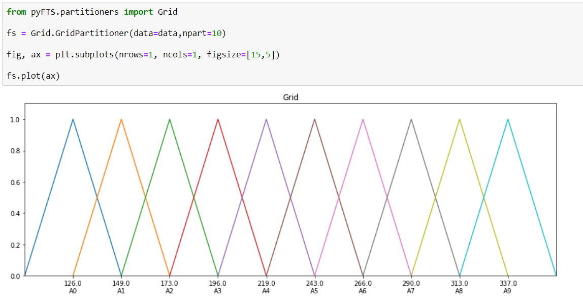
Visualization of the Fuzzy sets of the Linguistic Variable Adj Close

Slide 21
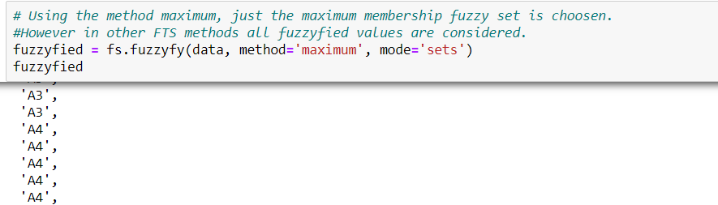
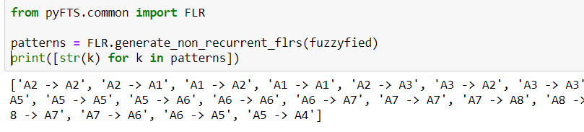
Fuzzification & Temporal Patterns

Slide 22
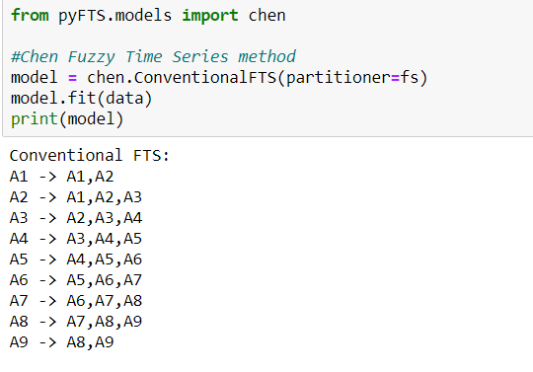
Rule generation

Slide 23
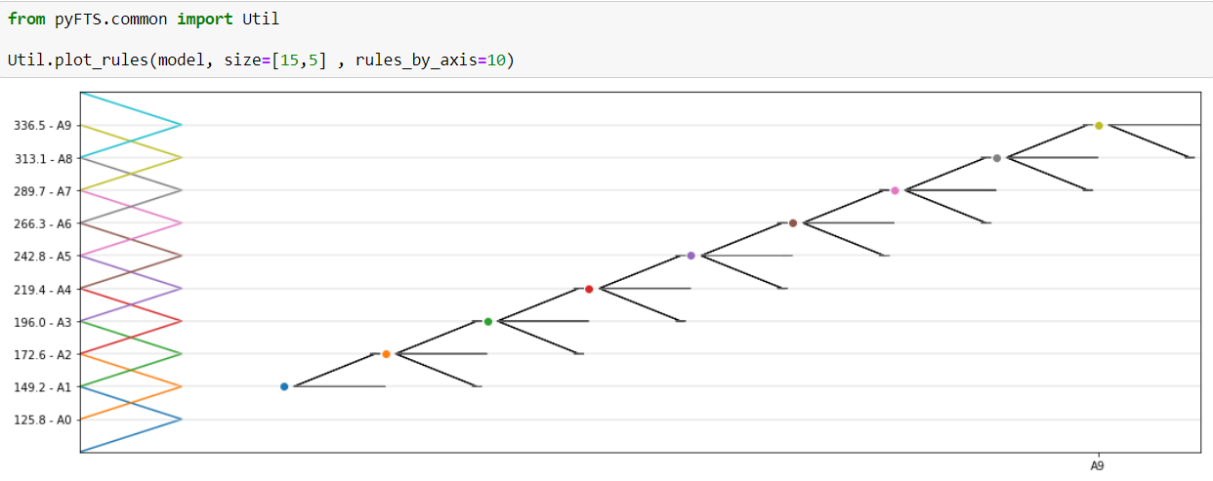
Rules plot

Slide 24
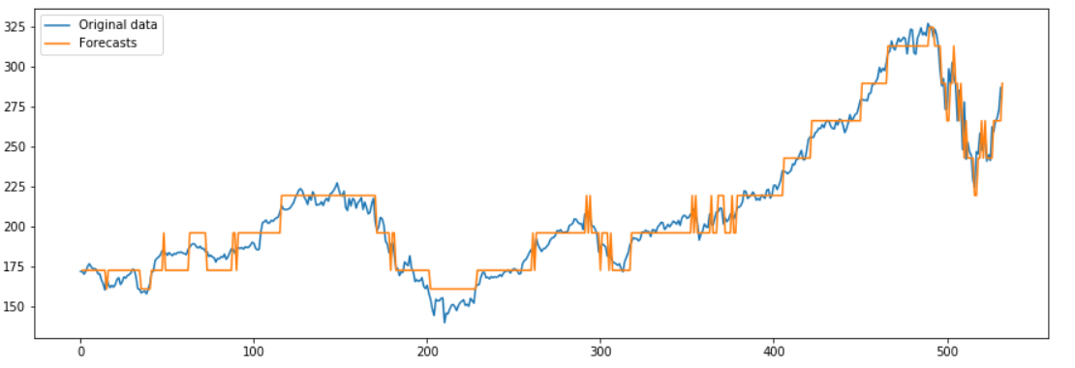
Forecasting

Slide 25
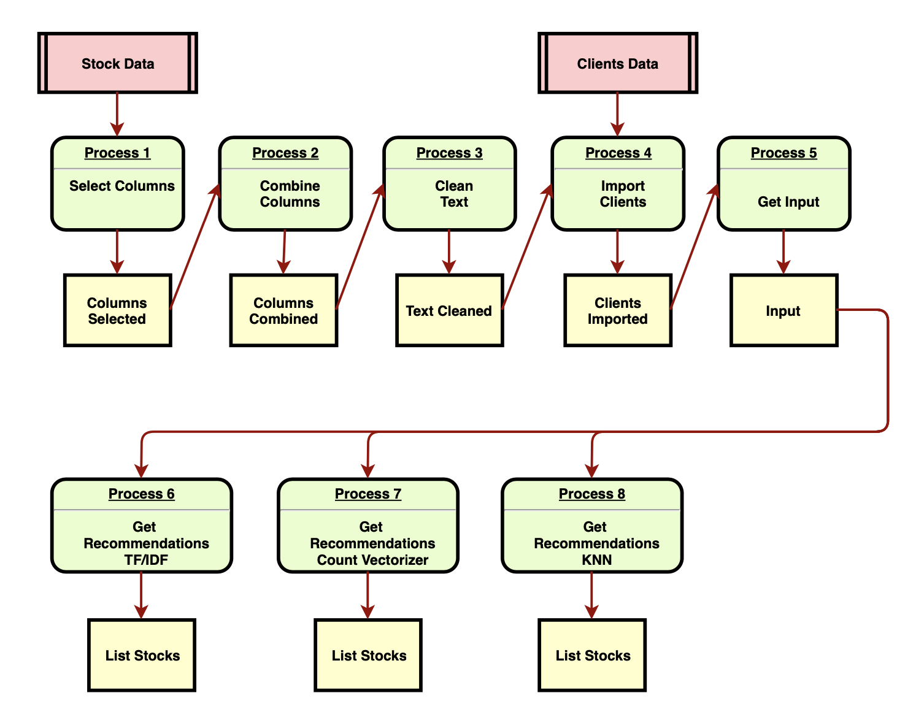
NLP

Slide 26
Chosen Algorithms
7

Slide 27
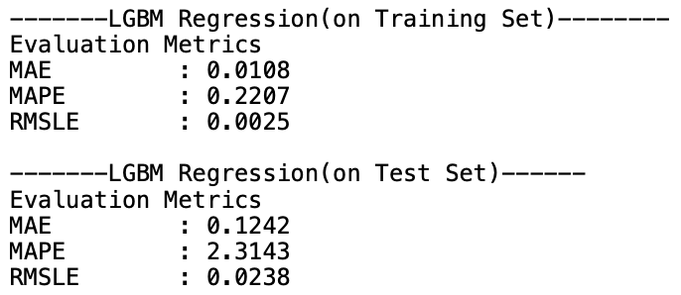
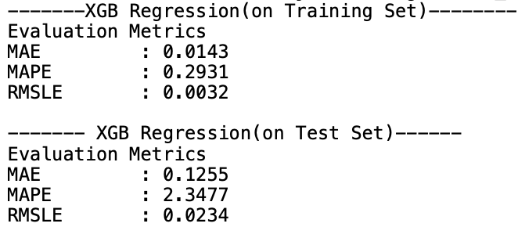
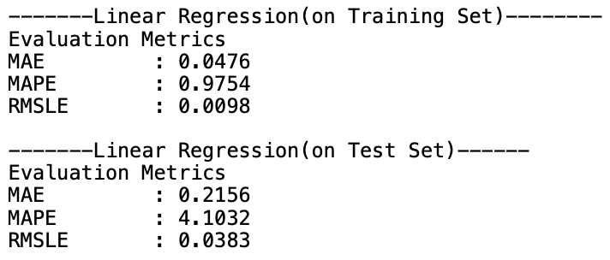
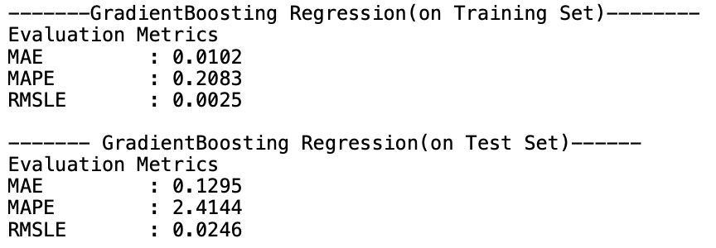
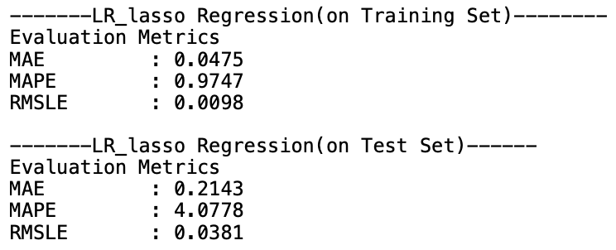
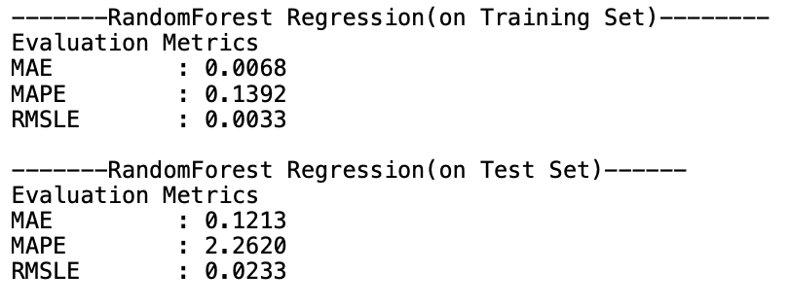
Stock Price Prediction-Long Term

Slide 28
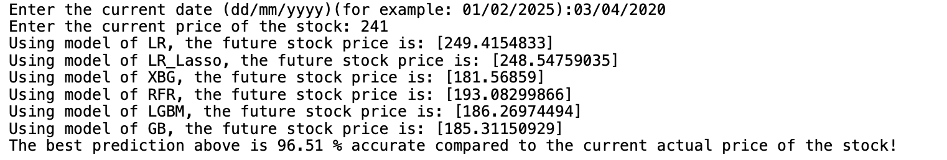
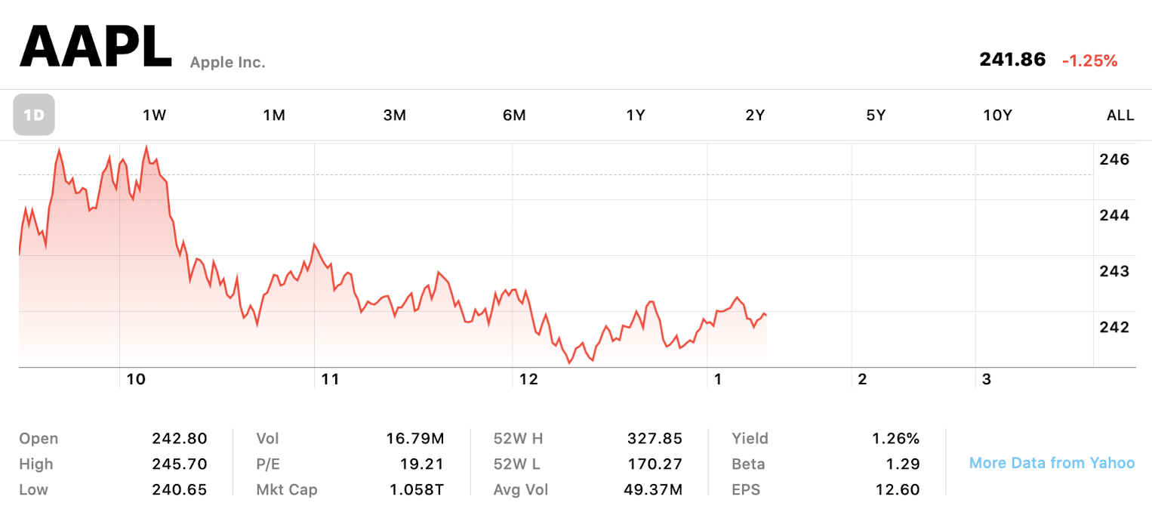
Stock Price Prediction-Long Term
Linear Regression Chosen
Fast and easy
The prediction error to the real-time stock price is less than 10%!
Amazing result!

Slide 29
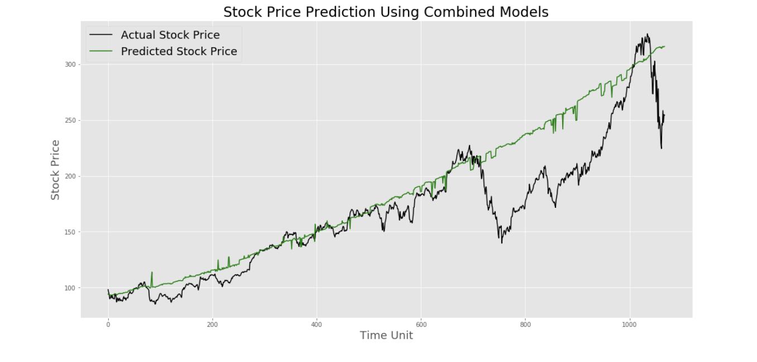
Stock Price Prediction-Long Term
The combined model with Linear Regression & Random Forest Regression works the best

Slide 30

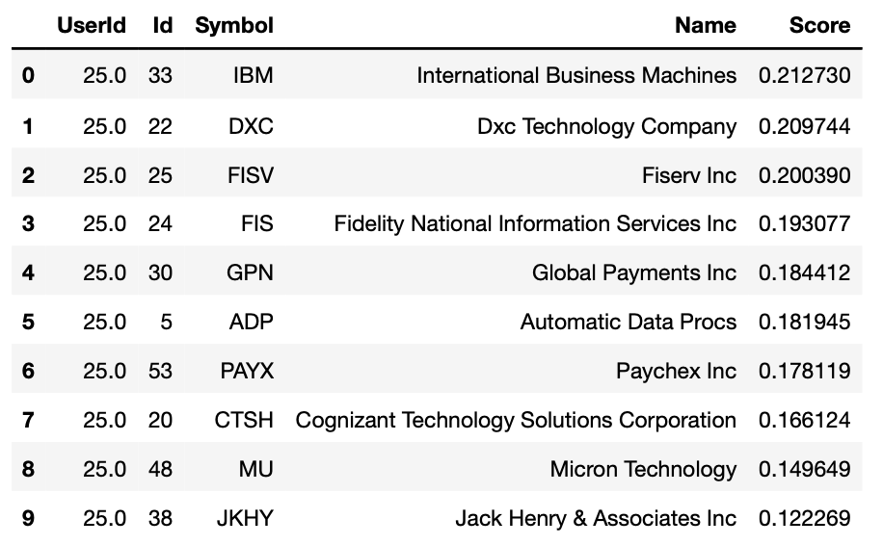


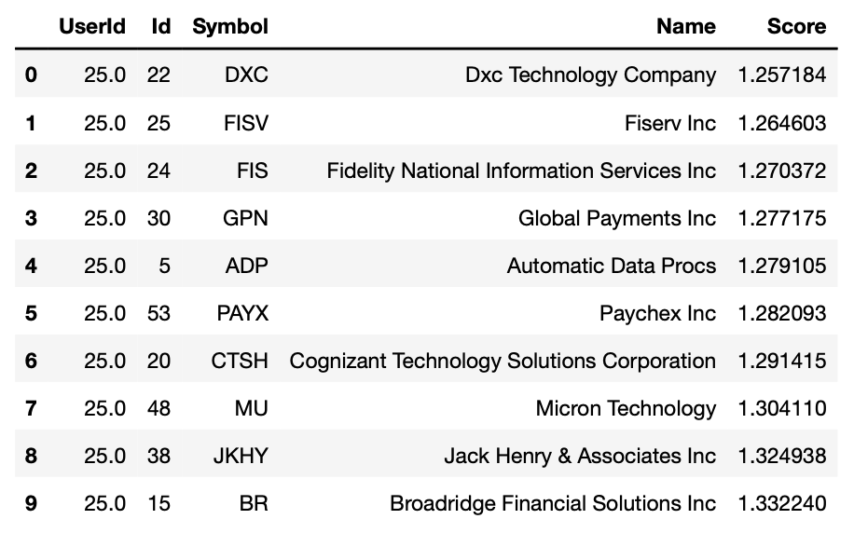
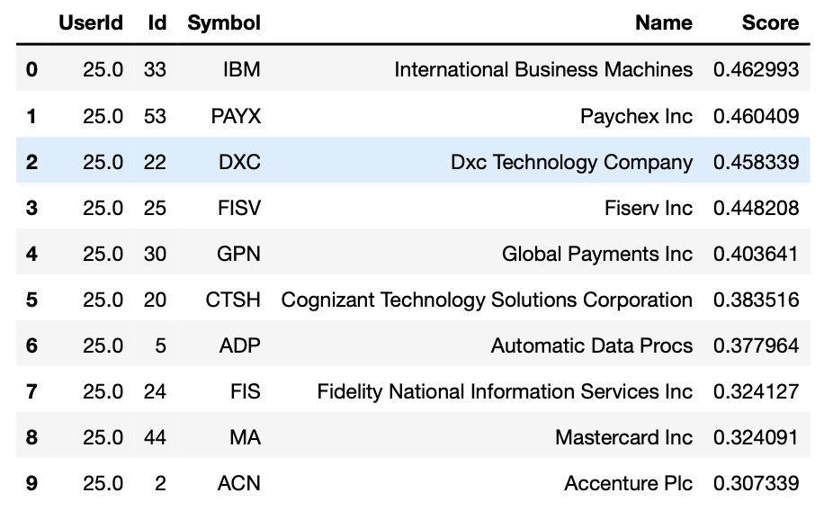
NLP
TF/IDF Chosen
All similar results, but TF/IDF easiest to tweak and the most accurate

Slide 31
Application Deployment
8

Slide 32
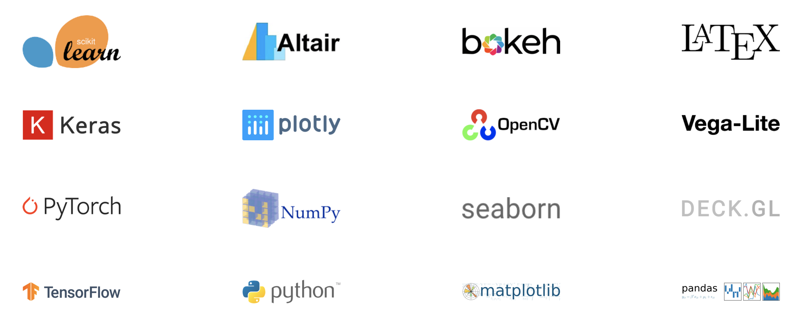

Using Streamlit
An open source app framework
Specifically designed for ML engineers
Working with Python
Compatible with major libraries & frameworks of ML

Slide 33


Cloud Deployment-AWS

Slide 34
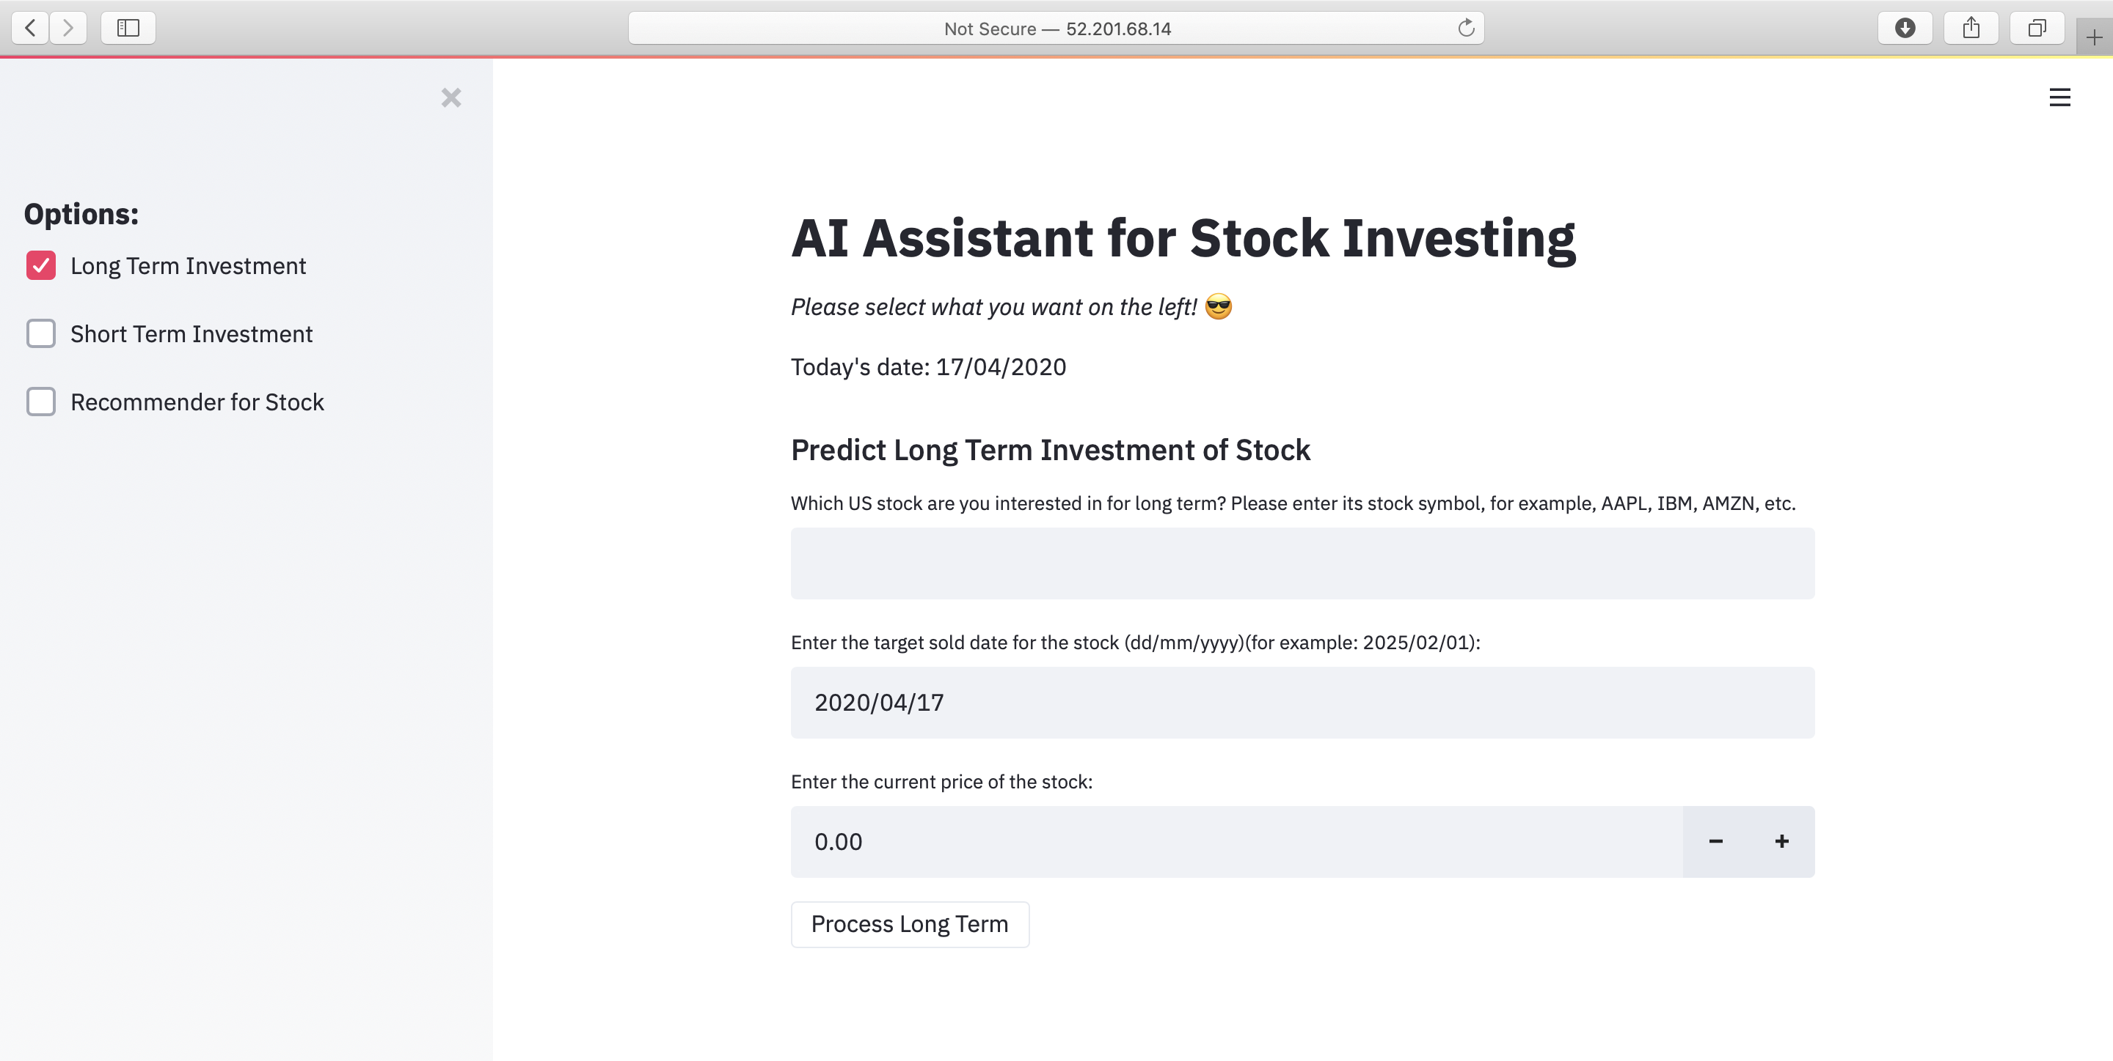
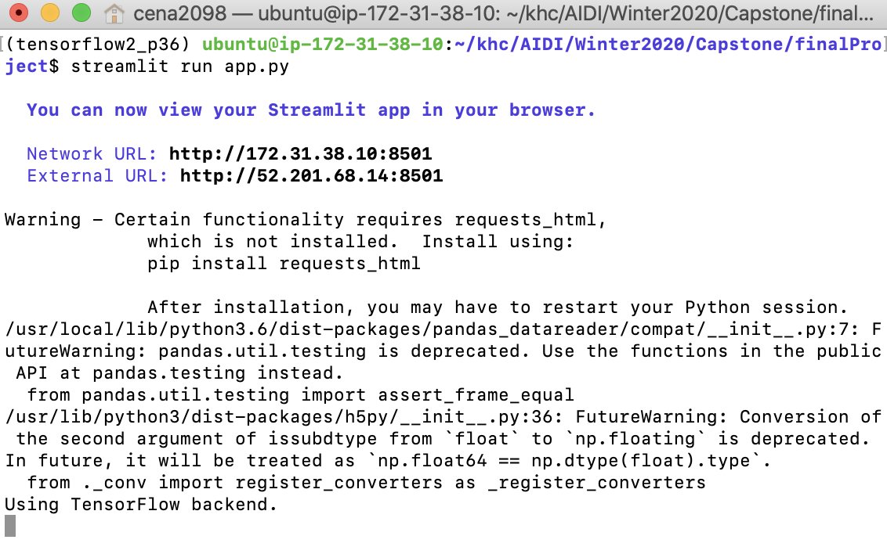
Running the App

Slide 35
Live Demo
9
Click this link to access the app-http://52.201.68.14:8501

Slide 36
Conclusion
10

Slide 37
With AI, predicting stock price is possible.
With AI, stock trading will be much easier.
The level of understanding of the dataset is the key to whether an AI project can be successful.
For future improvements, wider range of datasets in addition to stock prices are needed.
Also, possible combination with Neural Network models could lead to better predicted results.

Slide 38
Thanks!
Any questions?

